Slide 1
Comprehensive VHDL Hamdi Abdelbagi Phone: (937) 830-7761 Email: abdelbagih1@udayton.edu

Slide 2
Parameterized Design Entities
Aim
To learn further useful feature of the design entity for both synthesis and in large and complex designs
Topics covered
Array attributes
Port and Generic Maps
Generate Statement

Slide 3
Array Attribute ‘RANGE

Slide 4
Array and Type Attributes

Slide 5
Array and Type Attributes

Slide 6
Port Maps,
entity fulladder is port ( a : in std_logic; b : in std_logic; cin : in std_logic; sum : out std_logic; carry : out std_logic ); end fulladder; architecture behavior of fulladder is component halfadder port( a : in std_logic; b : in std_logic; sum : out std_logic; carry : out std_logic ); end component; signal s1,c1,c2 : std_logic:='0'; begin HA1 : halfadder port map ( a => a, b => b, sum => s1, carry => c1 ); HA2 : halfadder port map (s1, cin, sum, c2 carry <= c1 or c2; end;

Slide 7
More Example

Slide 8
Generic Parameters
entity example1 is generic ( width : integer := 7 ); port ( clk : in std_logic; load : in std_logic; in1 : in std_logic_vector(width downto 0); out1 : out std_logic ); end example1; architecture Behavioral of example1 is signal temp: std_logic_vector (width downto 0) := (others => '0'); begin process(clk) begin if (load = '0') then temp <= in1; elsif (clk'event and clk = '1') then out1 <= temp(width); temp(width downto 1) <= temp(width-1 downto 0); end if; end process; end Behavioral;

Slide 9
Generic Parameters

Slide 10
Generic Maps

Slide 11
Using Generics to Annotate Delays

Slide 12
Generate Statement

Slide 13
Generics and Generate

Slide 14
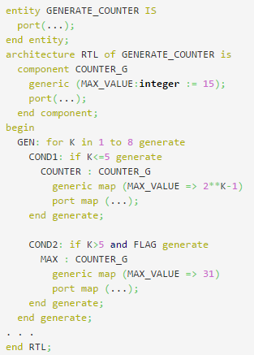
Conditional GENERATE Statement

Slide 15
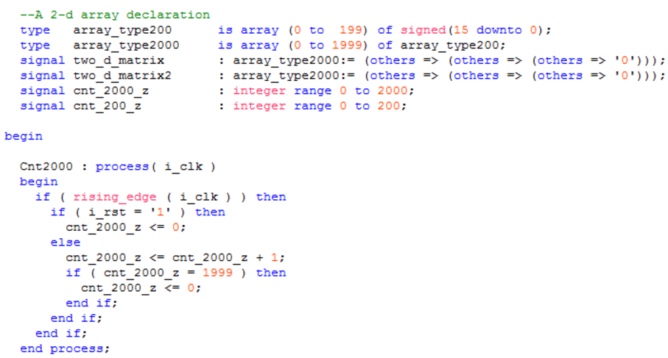
Code Layout Example

